Slide 1
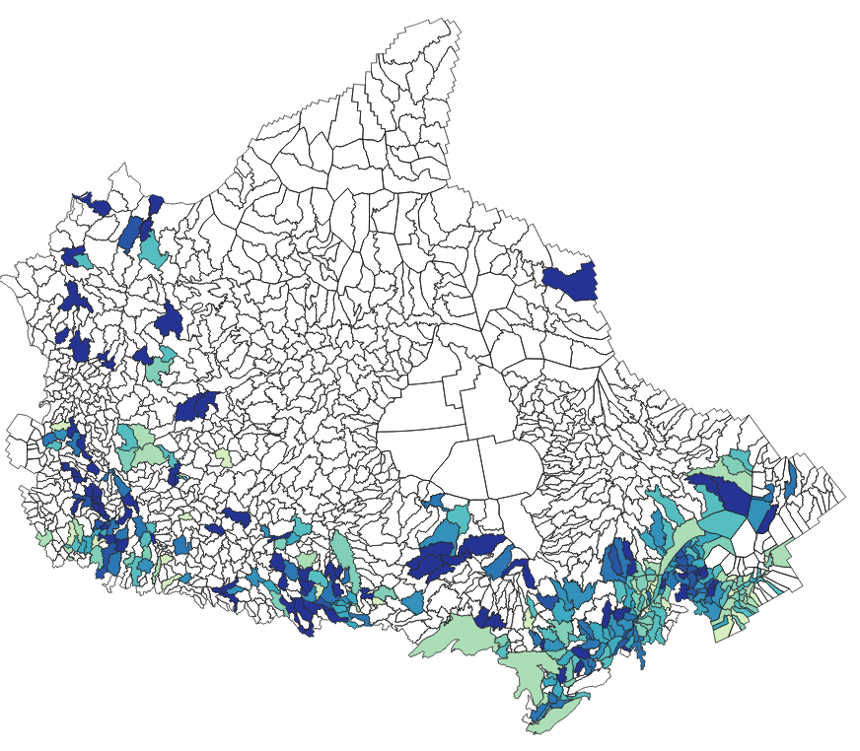
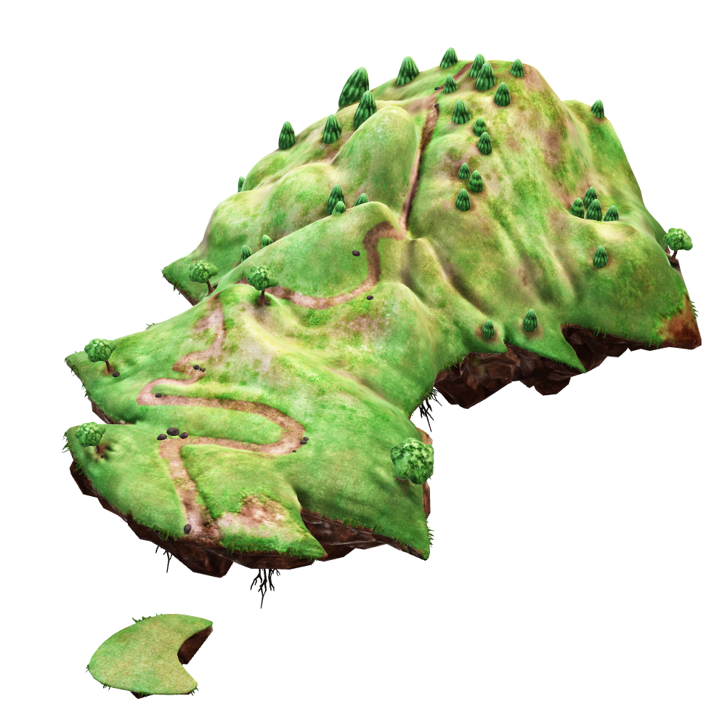
Introduction: Predicting probable flood drivers based on historical records and watershed characteristics
#Features = 40
10 Topography features : [ T1,…, T10]
13 Hydrological features : [H1,…,H13]
8 Vegetation: [V1,…,V8]
7 Shape: [S1,…,S7]
2 Climate features: [C1,C2]
# Non-labeled data = 902
# Labeled data = 435
#Labels = 12
Seasons
Flood related events
Mahkame Salimi Moghadam

Slide 2
Methods:
Data Preparation
Cleaning data
Normalizing data
Feature Selection
Principal component analysis (PCA)
Mutual information score
Multi-Label Classification NN
Choose model
Model evaluation
Categorizing data
Correlation matrix
Model hyper-parameter tuning

Slide 3
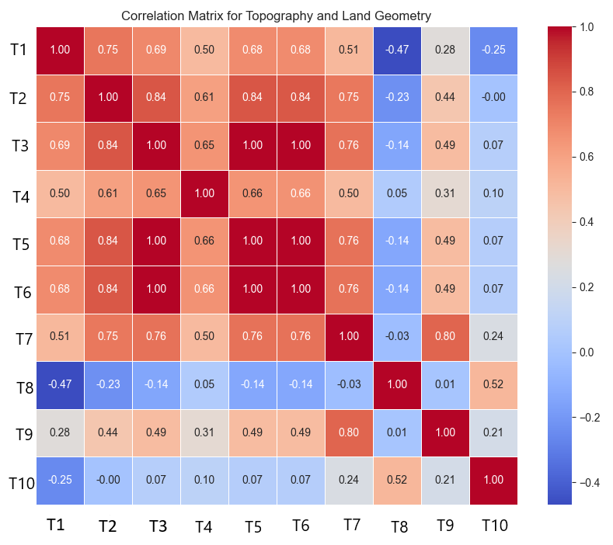
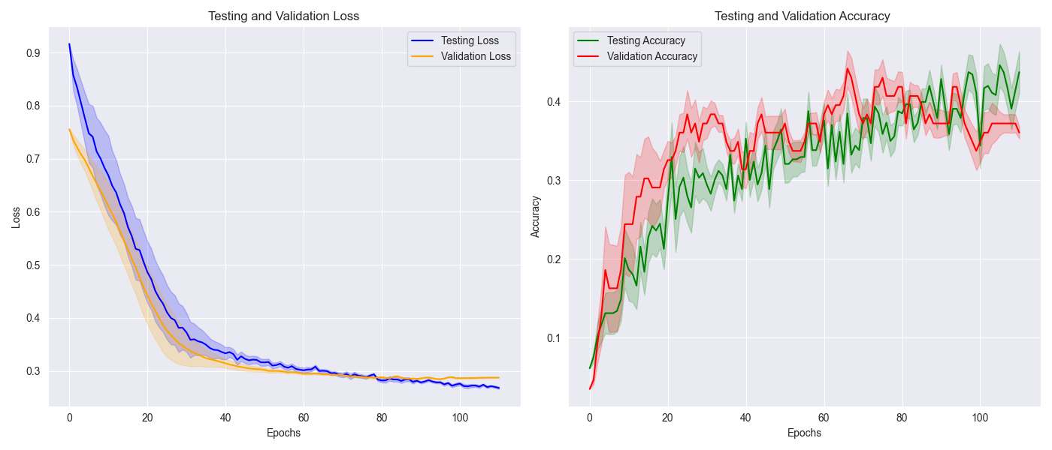
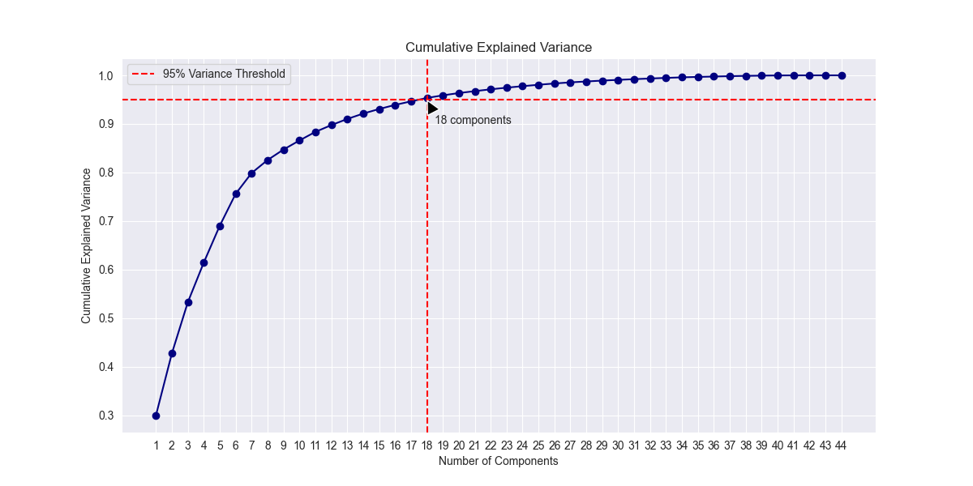
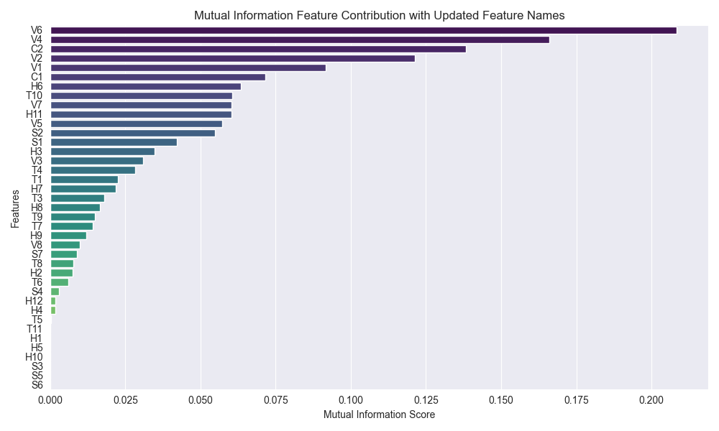
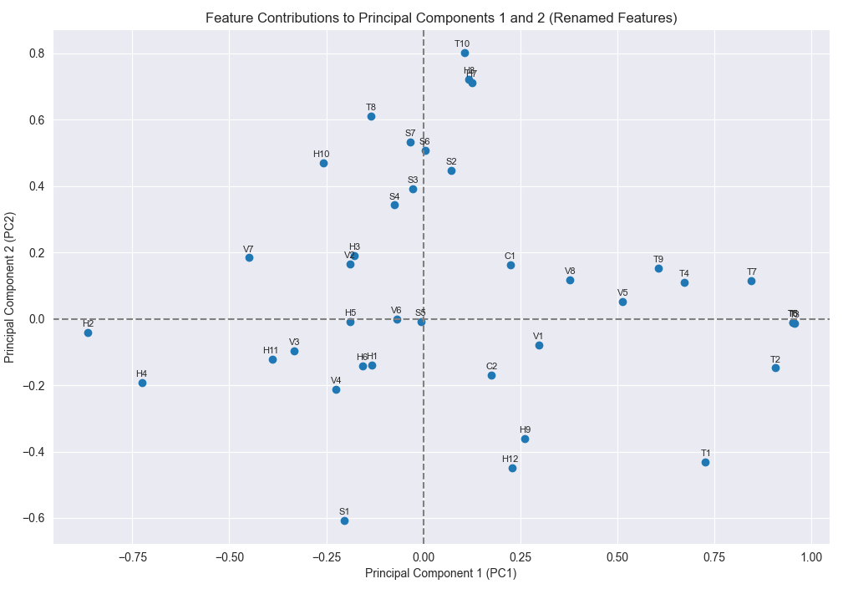
Results and tests:

Slide 4
References
J. Singh, S. Ghosh, S. P. Simonovic, and S. Karmakar. Identification of flood seasonality and drivers across Canada. Hydrological Processes, 35(10):e14398, 2021.
L. Stein, M. P. Clark, W. J. M. Knoben, F. Pianosi, and R. A. Woods. How do climate and catchment attributes influence flood-generating processes? a large-sample study for 671 catch-ments across the contiguous USA. Water Resources Research, 57(4):e2020WR028300, 2021.
S. Sinsomboonthong. Performance comparison of new adjusted min-max with decimal scal-ing and statistical column normalization methods for artificial neural network classification.International Journal of Mathematics and Mathematical Sciences, 2022(1):3584406, 2022.
H. McGrath and P. N. Gohl. Prediction and classification of flood susceptibility based on his-toric record in a large, diverse, and data sparse country. Environmental Sciences Proceedings,25(1), 2023.

